Slide 1
Intrusion Detection System using Deep Learning
Project By :- Rutuja Parab (32)
Shruti Sankhe (44)
Nehab Shaikh (50)
Guide Name: Smita Jawale

Slide 2
Abstract
Intrusion detection system (IDS) has become an essential layer in all the latest ICT system due to an urge towards cyber safety in the day-to-day world. Reasons including uncertainty in finding the types of attacks and increased the complexity of advanced cyber attacks, IDS calls for the need of integration of Deep Neural Networks (DNNs). In this paper, DNNs have been utilized to predict the attacks on Network Intrusion Detection System (N-IDS). A DNN with 0.1 rate of learning is applied and is run for 1000 number of epochs and KDDCup-’99’ dataset has been used for training and benchmarking the network. For comparison purposes, the training is done on the same dataset with several other classical machine learning algorithms and DNN of layers ranging from 1 to 5. The results were compared and concluded that a DNN of 3 layers has superior performance over all the other classical machine learning algorithms. Index Terms—Intrusion detection, deep neural networks, machine learning, deep learning.

Slide 3
Problem Definition
Problem occurring due to extended use internet.
Many challenges arise since malicious attacks are continually changing.
Sometimes software like anti-virus, firewalls etc. lack the ability to
detect unknown attacks.

Slide 4
Objectives
The main objectives include:
Intrusion Detection Systems (IDS) are designed to provide readiness to prepare for and deal with cyber attacks. This is accomplished through information collected from a variety of systems and network sources, which is then analyzed for security problems. IDS’ are generally deployed with the purpose to monitor and analyze user and system activity, audit system configurations and vulnerabilities, assess the integrity of any critical system and data files, perform statistical analysis of activity patterns based on the matching to known attacks, detect abnormal activity and audit operating systems.

Slide 5
Proposed System
An overview of proposed DNNs architecture for all use cases is shown in Fig. 1. This comprises of a hidden-layer count of 5 and an output-layer. The input-layer consists of 41 neurons. The neurons in input-layer to hidden-layer and hidden to output-layer are connected completely. Back-propagation mechanism is used to train the DNN networks. The proposed network is composed of fully connected layers, bias layers and dropout layers to make the network more robust.

Slide 6
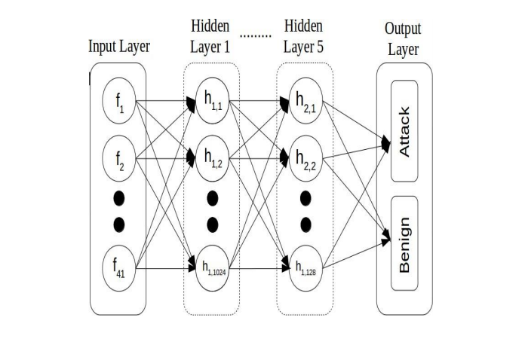
1. Proposed Architecture

Slide 7
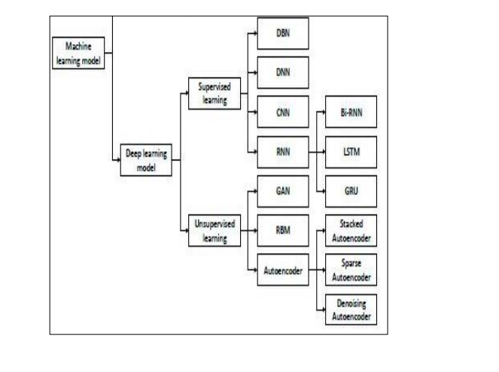
Algorithm Of IDS

Slide 8
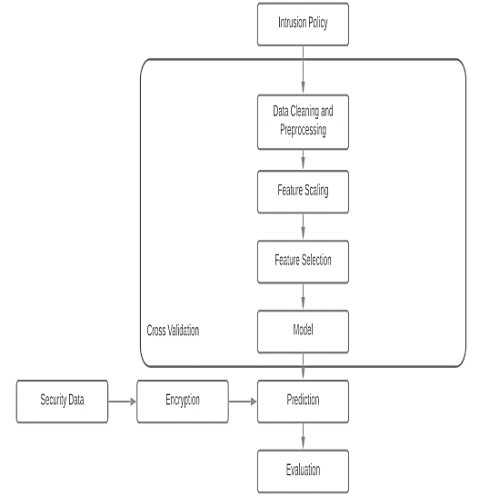
System Block Diagram

Slide 9
Implementation Details
Data Cleaning and Preprocessing:
The duplicate are already been removed.
The nan and Infinity values are replaced with zero initially.
Preprocessing operation is done on the dataset.
The requirement of One Hot Encoder is that input to it should be a matrix of integers denoting the value taken by the categorical Features.

Slide 10
Implementation Details
Feature Scaling:
Featuring scaling is performed.
Standard Scaler is used to perform this operation.
In Standard Scaler the average for a feature is calculated.
After Scaling each feature will have standard deviation of 1.

Slide 11
Implementation Details
Feature Selection:
Feature selection is performed to eliminate features which are irrelevant and redundant data.
Subset of the features are selected which fully represents all the features in the dataset in terms of accuracy and other metrics.
It is also possible that there is correlation between features when a large number of features are present.Feature selection also helps to eliminate this problem.
We have used Recursive Feature Elimination(RFE) to perform this operation.

Slide 12
Implementation Details
Prediction and Evaluation:
Various evaluation metrics such as accuracy, precision, recall, confusion matrix and f-measure are calculated on the predictions made by the model on test data.
A 10 fold cross validation was performed throughout the entire process.
The above evaluation metrics are calculated for every attack type i.e DoS, Probe, R2L and U2R.
The evaluations are also calculated for both the data with all the features and the data on which feature selection is performed. The evaluation metrics are compared for both the settings.

Slide 13
Scope
An IDS is a proactive intrusion detection tool used to detect and classify
intrusions, attacks, or violations of the security policies automatically at
network-level and host-level infrastructure in a timely manner.
Intrusion Detection Systems are very important software or hardware security
tools to remove threats that would otherwise occur when carrying information,
to prevent unauthorized access or abuse, and to report attacks to those
responsible for security.

Slide 14
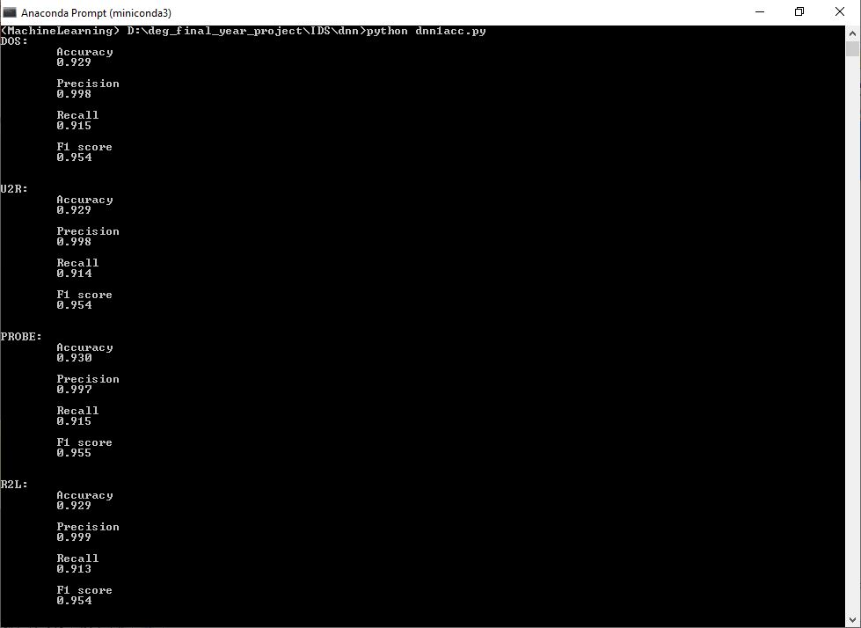
Result

Slide 15
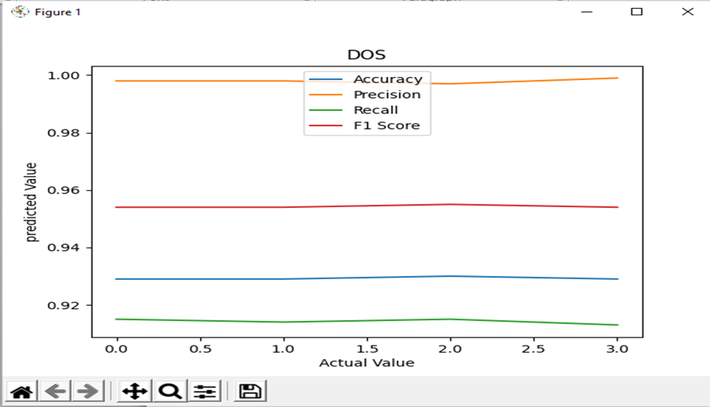
DOS Output

Slide 16
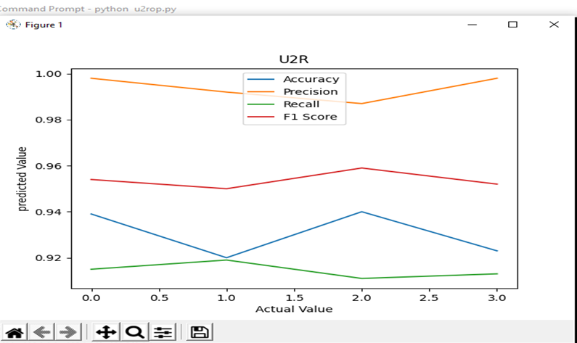
U2R Output

Slide 17
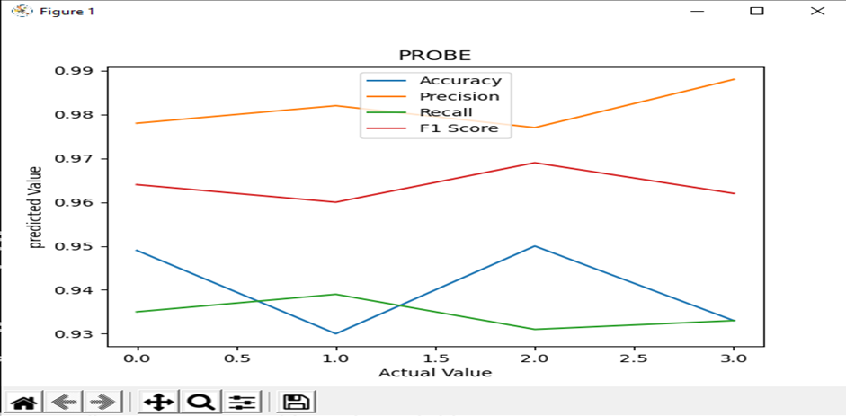
PROBE Output

Slide 18
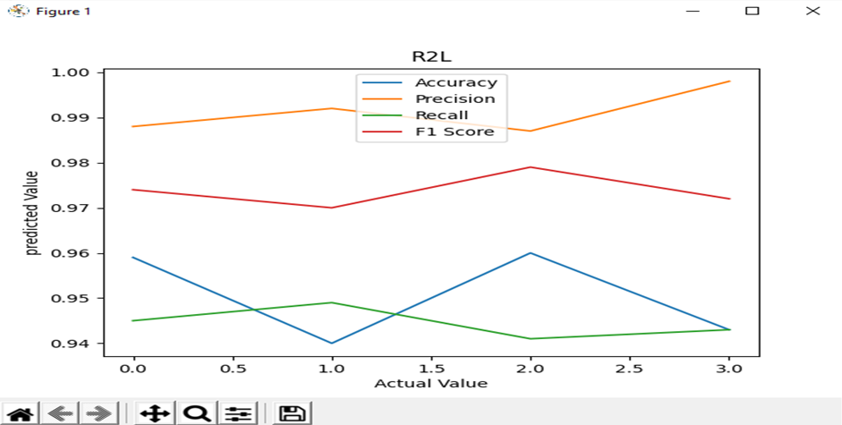
R2L Output

Slide 19
Conclusion
This paper has elaborately recapitulated the usefulness of DNNs in IDS comprehensively. For the purpose of reference, other classical ML algorithms have been accounted and compared against the results of DNN. The publicly available KDDCup-’99’ dataset has been primarily used as the benchmarking tool for the study, through which the superiority of the DNN over the other compared algorithms have been documented clearly. For further refinement of the algorithm, this paper takes into account of DNNs with different counts of hidden layers and it was concluded that a DNN with 3 layers has been proven to be effective and accurate of all.

Slide 20
References
[1] S.Niksefat, P.Kaghazgaran and B.Sadeghiyan “Privacy issues in intrusion detection systems: A taxonomy, survey and future directions”. Comput. Sci. Rev., 25, 69–78,2017.
[2] D. Archer, L. Chen, J. H. Cheon, R. Gilad-Bachrach, R. A. Hallman, Z. Huang, X. Jiang, R. Kumaresan, B. A. Malin, H. Sofia, Y. Song, and S. Wang, “Applications of homomorphic encryption,” Homomorphic Encryption.org, Redmond WA, Tech. Rep., July 2017.
[3] J. Anitha Ruth ; H. Sirmathi ; A. Meenakshi, “Secure Data Storage and Intrusion Detection in Cloud Using Mann and Dual Encryption through Various Attacks”, IET Information Security ( Volume: 13 , Issue: 4 , 7 2019 ), Tamil Nadu, India, 17 June 2019, Tamil Nadu, IEEE.
[4] Sarathiel Chaipa ; Mariki M Eloff ; Mariki M Eloff, “Towards the development of an Effective Intrusion Based Detection Model”, 2017 Information Security for South Africa (ISSA), Johannesburg, South Africa, 16-17 Aug. 2017, Pretoria, IEEE.
[5] Roshan Kumar, Deepak Sharma, “Signature - Anomaly based Intrusion Detection Algorithm”, 2018 Second International Conference on Electronics, Communication and Aerospace Technology (ICECA), Coimbatore, India, 29-31 March 2018, Haryana, IEEE.
[6] Virendra Barot, Sameer Singh Chauhan, Bhavesh Patel, “Feature Selection for Modeling Intrusion Detection”,I.J. Computer Network and Information Security, 2014, 7, 56-62
[7] I.Sharafaldin, A. H.Lashkari,, and A. A.Ghorbani “Toward generating a new intrusion detection dataset and intrusion traffic characterization” ICISSP, Funchal, Madeira-Portugal, 22–24 January 2018.

Slide 21
References
[8] R.Bost, R. A.Popa, S.Tu, and S.Goldwasser “Machine learning classification over encrypted data”. NDSS, San Diego, California, USA, 8–11 February 2015.
[9] L.Dias, J.Cerqueira, K.Assis and R.Almeida “Using artificial neural network in intrusion detection systems to computer networks” In Computer Science and Electronic Engineering (CEEC), Colchester, UK, 27–29 September 2017, pp. 145–150. New York, IEEE.
[10] Md Nasimuzzaman Chowdhury and Ken Ferens, Mike Ferens1 “Network Intrusion Detection Using Machine Learning”,The Steering Committee of The World Congress in Computer Science, Computer Engineering and Applied Computing (WorldComp). (2016)
[11] Saroj Kr. Biswas CSE dept., NIT Silchar, Assam, India, 788010,”Intrusion Detection Using Machine Learning: A Comparison Study”, Volume 118 No. 19 2018, 101-114
[12] CHUANLONG YIN , YUEFEI ZHU, JINLONG FEI, AND XINZHENG HE “A Deep Learning Approach for Intrusion Detection Using Recurrent Neural Networks”,Received September 5, 2017, accepted October 5, 2017, date of publication October 12, 2017.
[13] Sarker, Iqbal H.; Abushark, Yoosef B.; Alsolami, Fawaz; Khan, Asif Irshad”IntruDTree: A Machine Learning Based Cyber Security Intrusion Detection Model”, ; Accepted: 15 April 2020; Published: 6 May 2020.
[14] G. Meena and R. R. Choudhary, "A review paper on IDS classification using KDD 99 and NSL KDD dataset in WEKA," 2017 International Conference on Computer, Communications and Electronics (Comptelix), Jaipur, 2017, pp. 553-558, doi: 10.1109/COMPTELIX.2017.8004032.

